Slide 1
Database Project
Humaiz Tariq and Usman Ali
I160133 – i16014

Slide 2
Online Voting System
Online voting system is a web-based voting system that will help to manage elections easily and securely.
Traditional voting system is very inefficient in the sense that it is time consuming and requires a large human resource to conduct.
The web-based system will be connected to a database to ensure that all information is easily accessible, while ensuring its safety.

Slide 3
Functionalities
Login/password
CRUD
Voting
Not implemeneted:
Security Verification through phone numbers and CNIC

Slide 4
Advantages/Benefits of the proposed system:
1. Viewing the profile of the candidates
2. Voting availability throughout the day.
3. All people in a constituency who do not vote can be notified to vote
4. Greater accuracy than traditional system
5. Reliability,
a. through direct results after polling deadline
b. convenient for people not living in their constituency c. very reduced chance of manipulation in data
6. Validity of credentials can be checked with NADRA (existing database)
7. Automating the voting system to reduce human error

Slide 5
Tools and Technologies:
The following tools were used in project development:
MS Word
MS Power Point
SQL Developer
XAMPP
GitHub Atom Text Editor
Chrome and Internet Explorer
Windows 10

Slide 6
Scope
Voter
Admin
Candidate
Voting Procedure

Slide 7
Work Division:
Documentation:
80% Usman Ali and 20% Humaiz Tariq
Frontend:
75% Humaiz
25% Usman
Backend:
75% Usman
25% Humaiz
Parsing:
50% both.

Slide 8
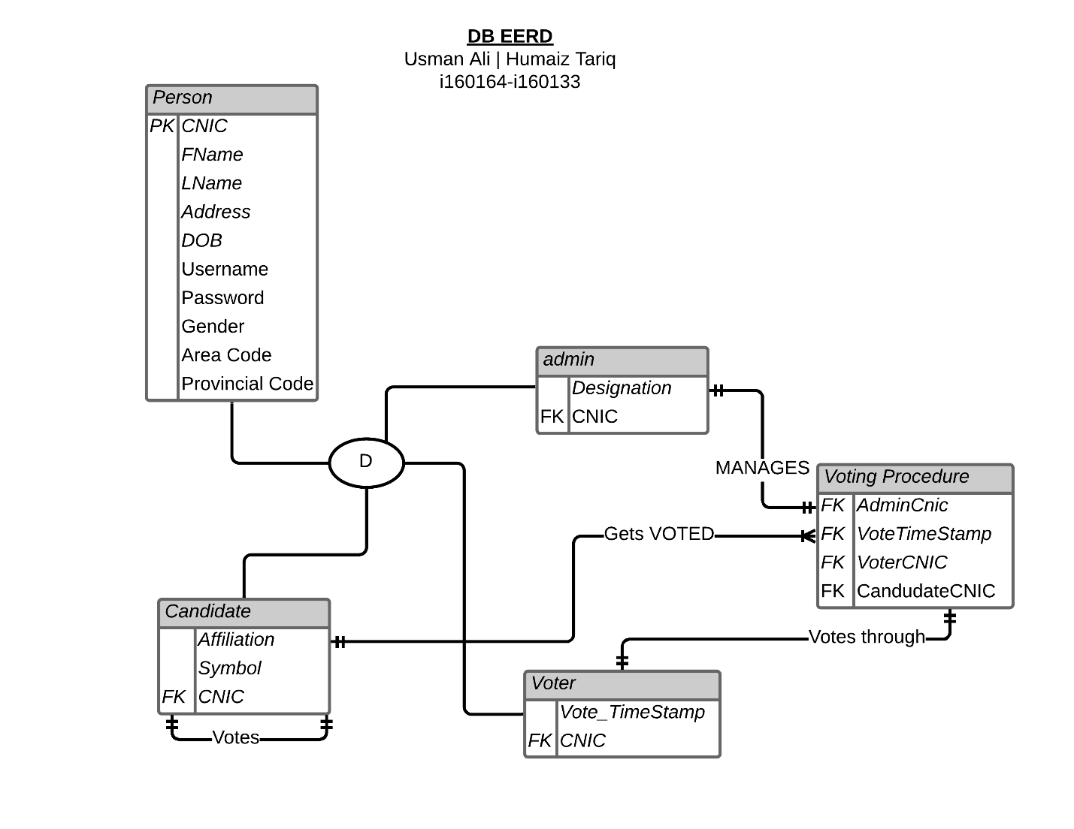

Slide 9
Normalization
Person: CNIC, Fname, Lname, Address, DOB, Username, Passsword, Gender, Area Code, Provincial Code
Admin: Designation, Cnic
Candidate: Ccnic, affiliation, symbol
Voter: VCNIC, VoteTimeStamp
VotingProcedure: VoterCnic, Vote TimeStamp, AdminCnic,CandidateCnic

Slide 10
Thank You
Please: One of our group members gets very nervous, please be patient and forgive his hand shaking and ecstatic movements! Thanks.

